Slide 1
Datasets
Personal Exposure to pollution (Inhale → Patches etc has to be personal)
Pollution (Open Weather – up until 200 metres
Physiological Responses tracker (Fitbit, Garmin, Apple health)
“GPS Tracker”
Notes:
The point is that each dataset is unique. Any dataset alone doesn’t really add any value!
Physiological response is mostly useful because → As an example, consider two individuals who are both in the same place at the same time, but one is driving while the others jogging. Every individual belonging to a different group reacts differently to the same level of pollution.
Open weather → Basically tells you air quality and pollution level (up to 200 metres precise). Could I measure it as a distance from a station? It has to be up to a meter or what’s the calculation behind it?

Slide 2
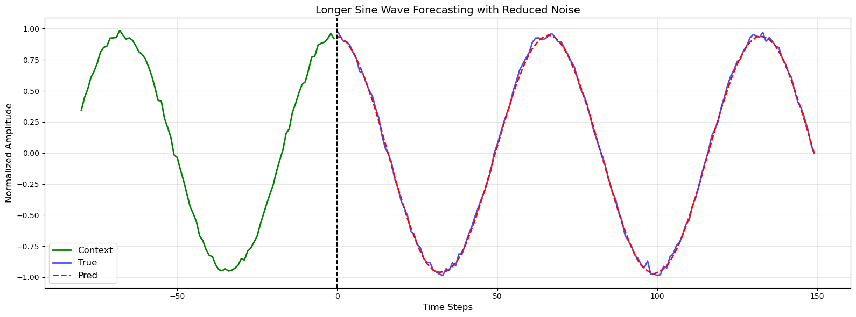
Time Series encoder decoder transformer Sine Forecasting

Slide 3
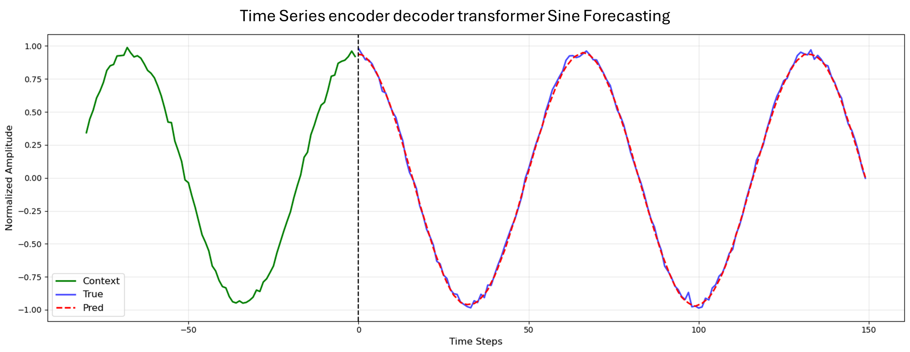

Slide 4


Personal Exposure to pollution (Inhale → Patches etc has to be personal)
(Open Weather) – granularity up to 200m
“GPS coordinates”
Notes:
The point is that each dataset is unique. Any dataset alone doesn’t really add any value!
Physiological response is mostly useful because → As an example, consider two individuals who are both in the same place at the same time, but one is driving while the others jogging. Every individual belonging to a different group reacts differently to the same level of pollution.
Open weather → Basically tells you air quality and pollution level (up to 200 metres precise). Could I measure it as a distance from a station? It has to be up to a meter or what’s the calculation behind it?

Slide 5
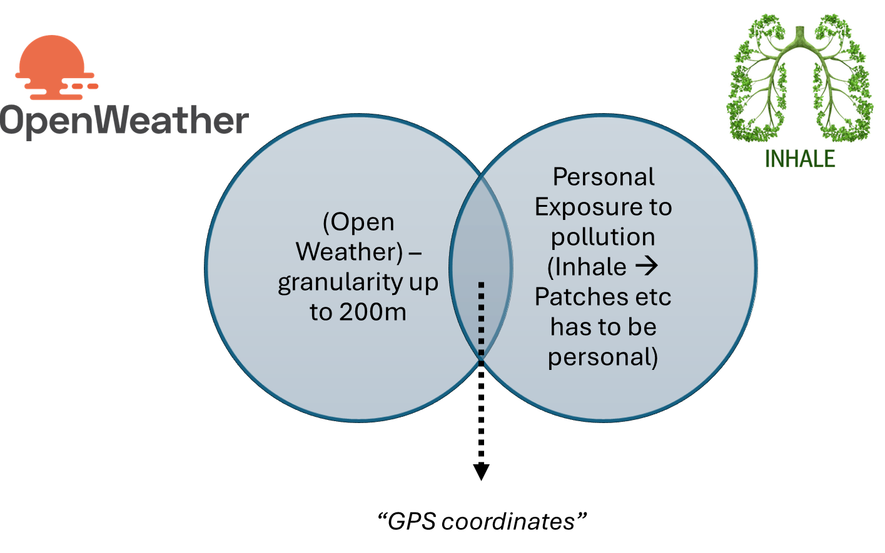

Slide 6
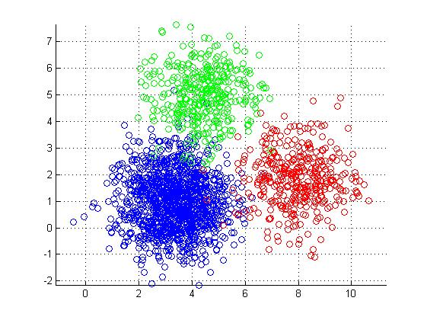
Project Plan
Data Ingestion & EDA
K-clustering classes identification
Transformer
Fine Tune x individual
“First Evaluation”
“Second Evaluation”
Healthy class
PM2
CO
Predicted HRV, skin etc

Slide 7
Data Ingestion & EDA
K-clustering classes identification
Transformer
Fine Tune x individual
“First Evaluation”
“Second Evaluation”
Healthy class
PM2
CO
Predicted HRV, skin etc

Slide 8
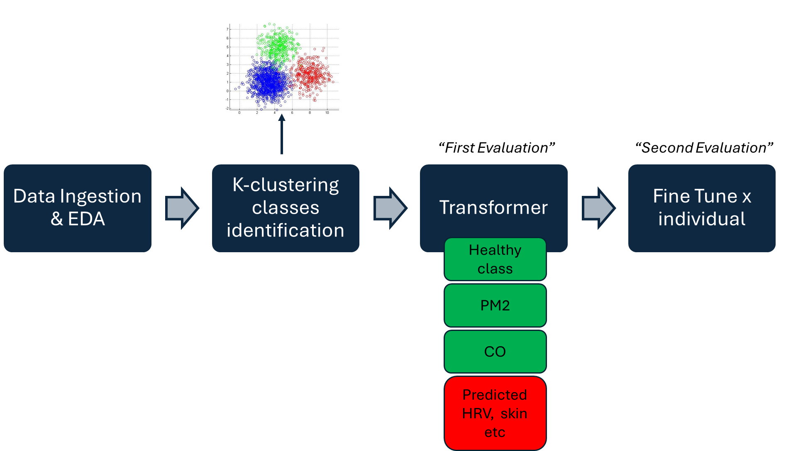
Classifier and Transformer based architecture

Slide 9
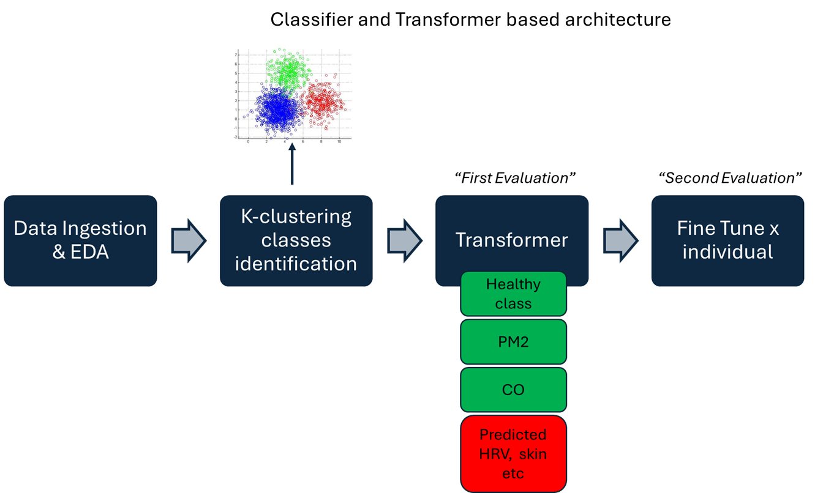

Slide 10
General Model Design – First Model
Input Vector (including physiological variables, pollution measures and individual health class)
Transformer Encoder (including positional encoding, stacked encoder blocks)
Latent Space with Transformer encoder-decoder
Transformer Decoder (including positional encoding, decoder blocks)
“Multi-head attention”
“Learned mapping between pollution and physical response”
“Prediction of future states”
Notes:
Loss Function: Cross-Entropy Loss
The Transformer is trained using the cross-entropy loss, which measures the difference between the predicted output probabilities and the true labels.

Slide 11
The final Plan
Input Vector (including physiological variables, pollution measures and individual health class)
Encoder (including positional encoding, stacked encoder blocks)
Latent Space with Transformer encoder-decoder – This has to be VAE
Transformer Decoder (to predict next Breath rate steps) and then what?
“Multi-head attention”
“Learned mapping between pollution and physical response”
“Prediction of future states”
Notes:
Loss Function: Cross-Entropy Loss
The Transformer is trained using the cross-entropy loss, which measures the difference between the predicted output probabilities and the true labels.

Slide 12
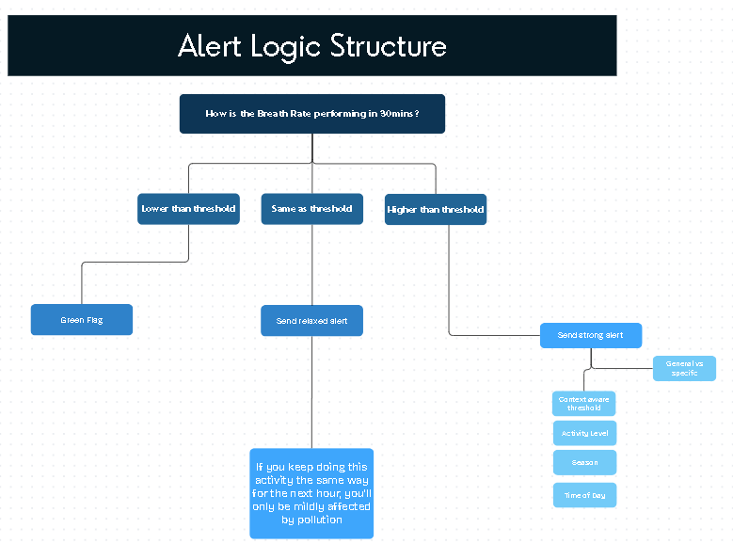
The final Plan
Notes:
Loss Function: Cross-Entropy Loss
The Transformer is trained using the cross-entropy loss, which measures the difference between the predicted output probabilities and the true labels.

Slide 13
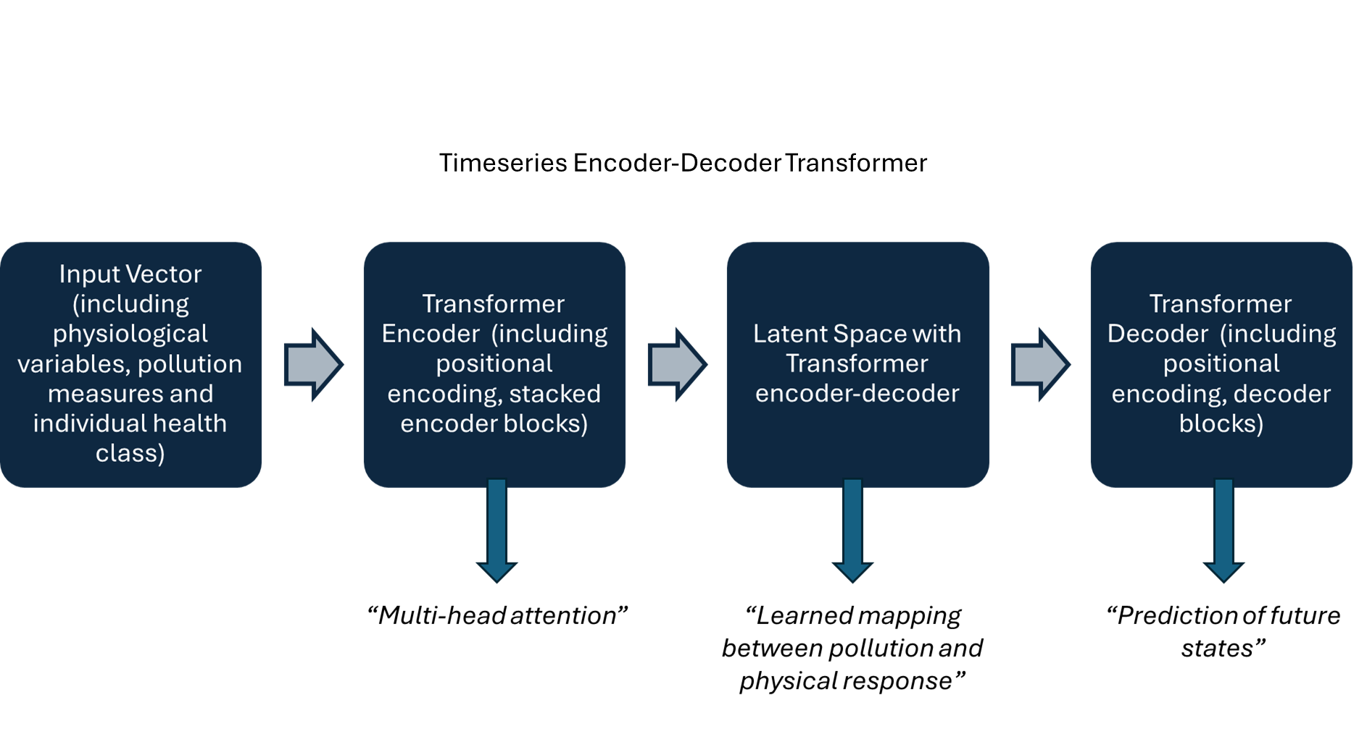

Slide 14

Timeseries Encoder-Decoder Transformer

Slide 15
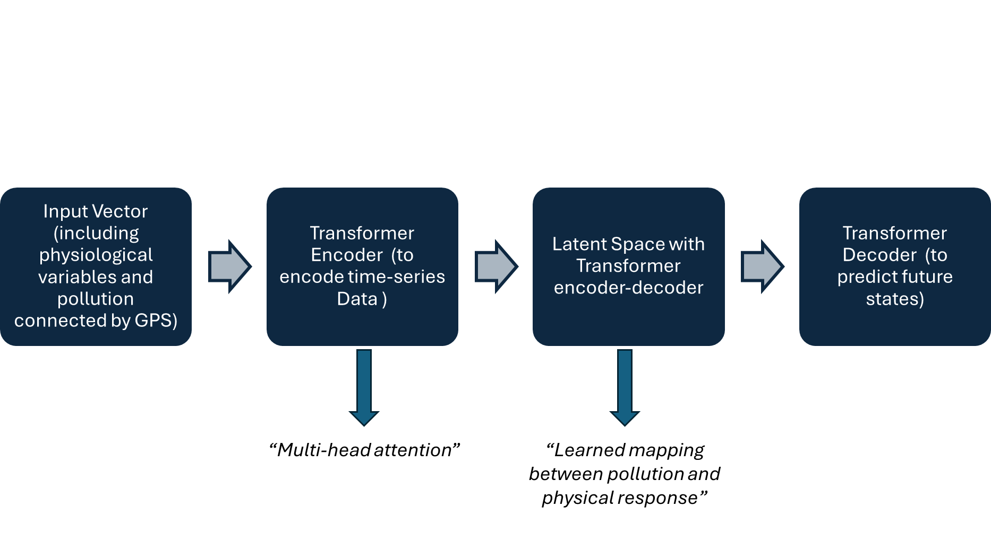

Slide 16
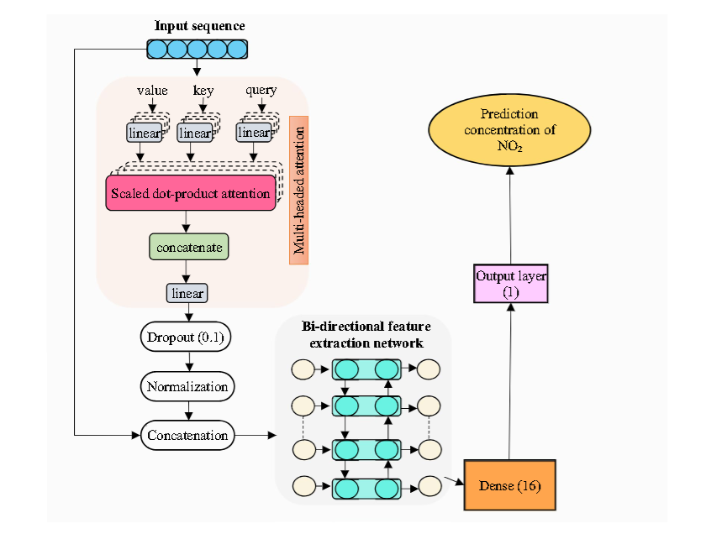
A bidirectional LSTM encoder-decoder transformer
Notes:
BREATH‑Net: a novel deep learning framework for NO2prediction using bi‑directional encoder with transformer

Slide 17
Timeline
Exploratory Data Analysis and literature Review
June
Data Preprocessing and Model training
July
Models' evaluation and Report writing
August

Slide 18
Model Architecture design
Transformer VAE on processed dataset
Push Latent Space
Freeze Last layers
Fine tune to fitbit data

Slide 19
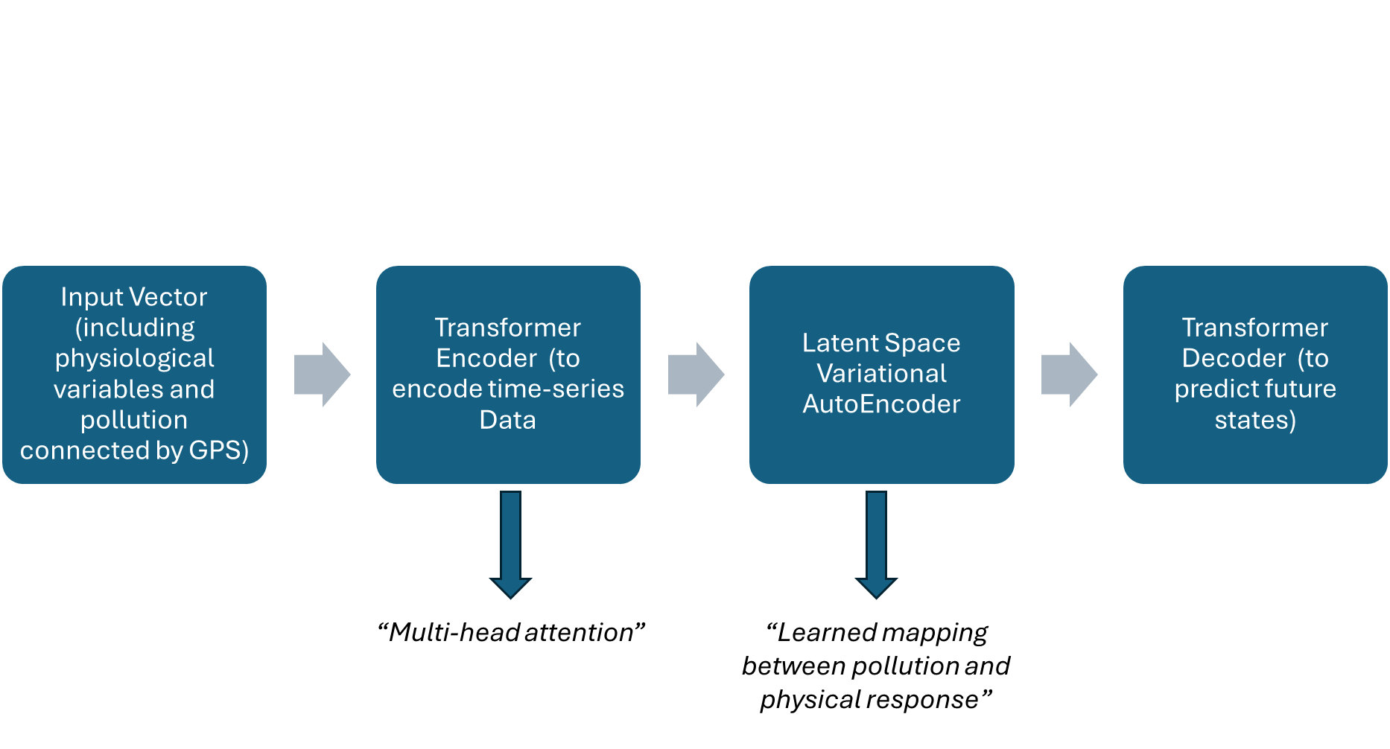
General Model Design – First Model
Notes:
Loss Function: Cross-Entropy Loss
The Transformer is trained using the cross-entropy loss, which measures the difference between the predicted output probabilities and the true labels.

Slide 20
Model Plan
Data Ingestion & EDA
K-clustering classes identification
Variational Autoencoder
Fine Tune x individual
“First Evaluation”
“Second Evaluation”
“Healthy class”
PM2
CO etc
(Predicted HRV, HR, skin etc)

Slide 21
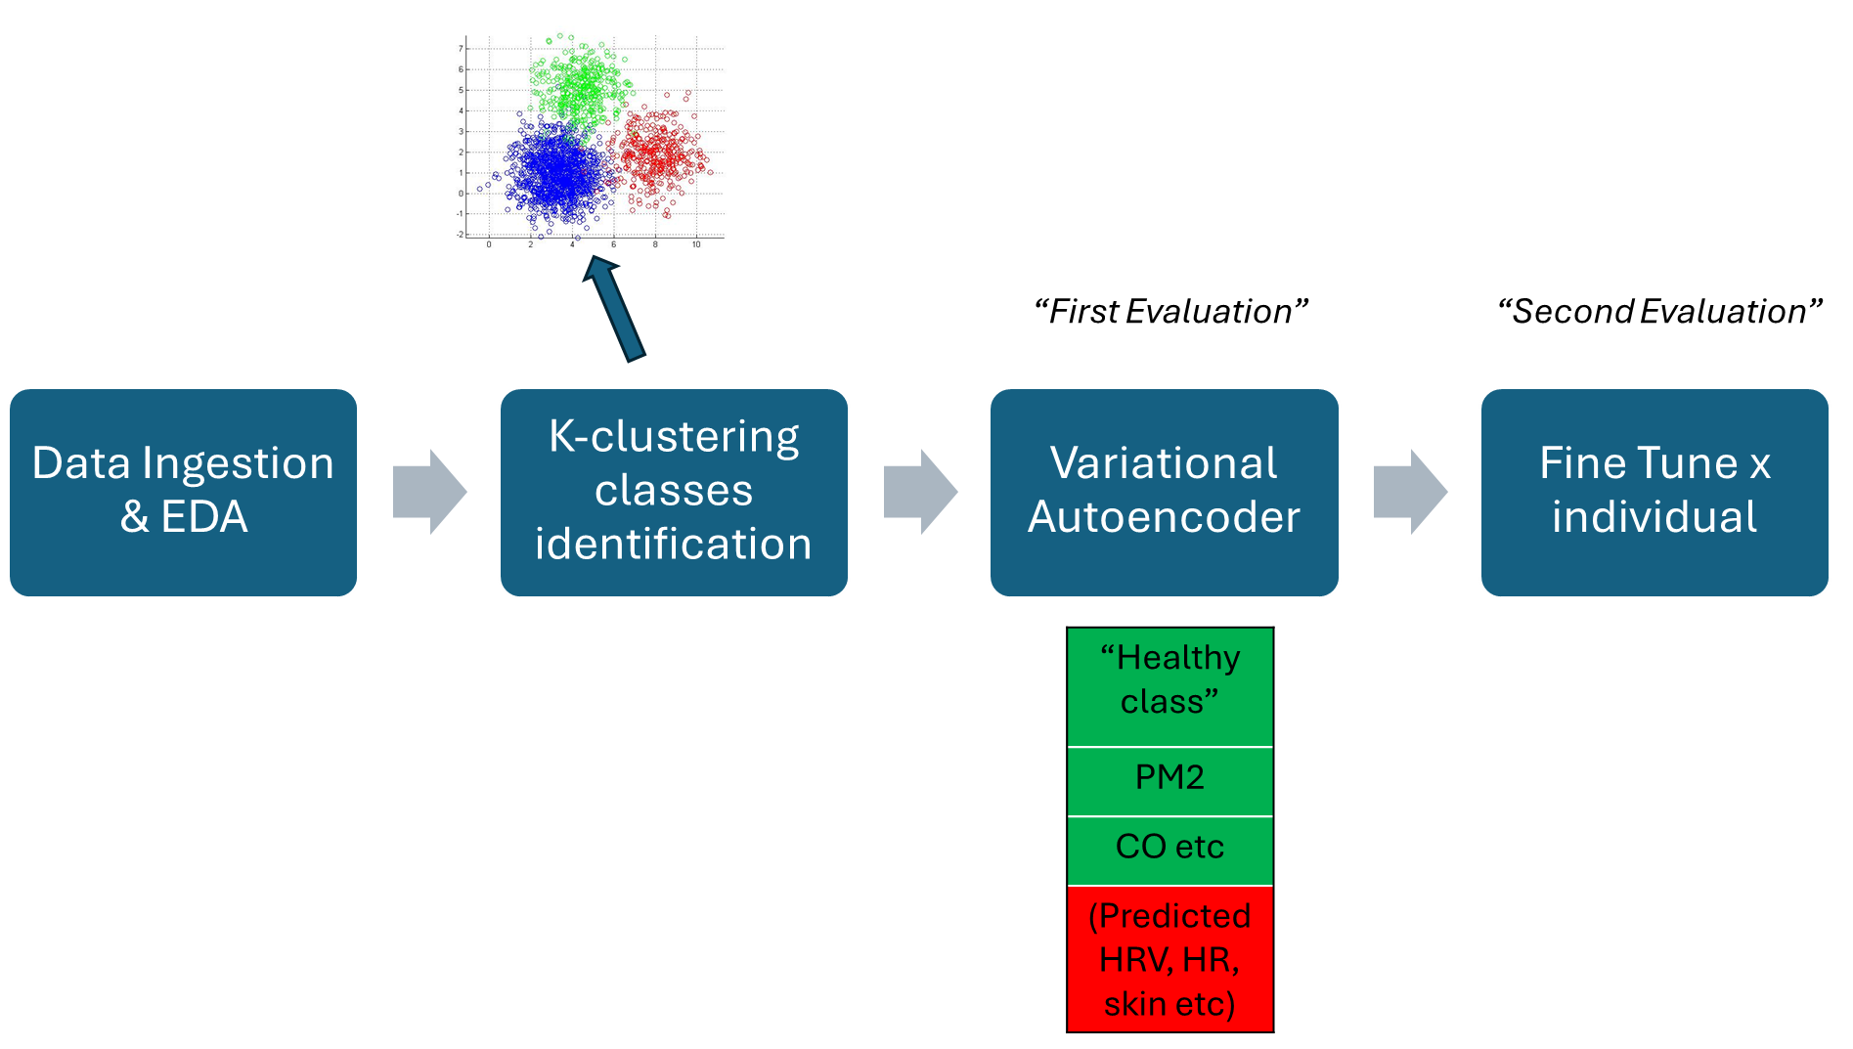

Slide 22
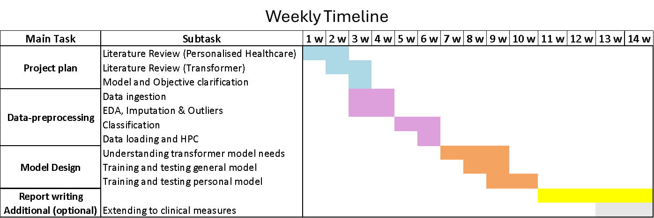
Weekly Timeline

Slide 23
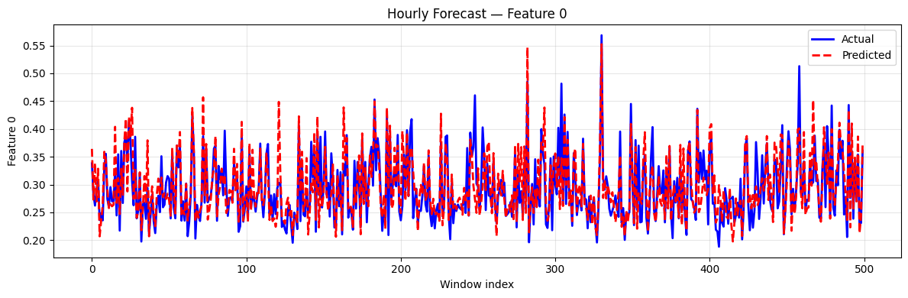

Slide 24
Questions
Are we supposed to merge the two datasets together? And if yes is it on time? Or how do we link pollution vs physical response? We do have a breadth both app
Also, do we get the data at least every second? Maybe – check the dataset
Does It make sense to classify the people in category? Since I am feeding it to the VAE – wouldn’t that also increase error propagation?
We are doing predictions of health responses based on pollution – why are we not using transformers time series or lstm? It’s time series data!

Slide 26
The final Plan
Input Vector (including physiological variables, pollution measures
Customer Transformer Encoder
Variational Latent Space (GAN)
Transformer Decoder (to predict next Breath rate steps) and then what?
A traditional Transformer Encoder, customized to retrieve attention weights. Including:
Multi-head self attention
Feedforward Network
Normalization and dropout
Notes:
Loss Function: Cross-Entropy Loss
The Transformer is trained using the cross-entropy loss, which measures the difference between the predicted output probabilities and the true labels.

Slide 27
Customer Transformer Encoder
A traditional Transformer Encoder, customized to retrieve attention weights. Including:
Multi-head self attention
Feedforward Network
Normalization and dropout

Slide 28
Latent Space is created
Took the last step of the latent space and got:
Got the mean of it
Got the variance of it
Now my latent space (thanks to the reparameterization technique) reflects a Gaussian Normal Distribution.

Slide 29
Latent Space becomes Variational
The latent step (last step of encoder) now becomes Variational with a GAN’ s technique.
Indeed, during the training loop we have a:
Generator = it learns to generate latent variables z from data that look like they came from a standard normal distribution (N(0, I)).
Discriminator = learns to tell apart real latent samples (from a true normal distribution ) from fake latent samples generated by the model.

Slide 31
Sequential Decoder
The decoder takes the latent vector z, which encodes information from the input time series, and maps it back into the future sequence of predictions.
It uses a simple feedforward network to transform this compressed representation into a multi-step forecast covering all output features.

Slide 32
Input Vector (including physiological variables, pollution measures
Customer Transformer Encoder
Variational Latent Space (GAN)
Transformer Decoder (to predict next Breath rate steps) and then what?
A
B
C
D
A traditional Transformer Encoder, customised to retrieve attention weights. Including:
Multi-head self attention
Feedforward Network
Normalization and dropout

Slide 33
A
The input includes tot number of features
To the input I will add Positional Encoding

Slide 34
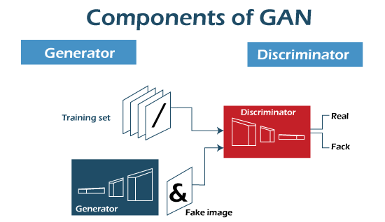
Encoder
6 transformer encoder layers with 8 heads x layer + position-wise feedforward dmodel → dff → dmodel with Relu and dropout
Variational Latent Space
Input
Transformation
Decoder
Output
μ
log(σ)
Z = μ +ε×σ
Reparam trick
Encoder’s output
Last step
Latent vector
Multivariate Sequence Input (T x B x F)
e.g. Breath rate avg, pm2.5, cyclical time etc.
Embedding
(128 dim)
Autoregressive forecasting with scheduled sampling
Future physiological and pollution states
Positional Encoding
h1
h2
h3
h4
h5
h6
h7
h8

Slide 35
Hybrid Transformer-Gan model for physiological and time-series forecasting
Transformer Encoder
6 transformer encoder layers with 8 heads x layer + position-wise feedforward dmodel → dff → dmodel with Relu and dropout
Variational Latent Space
Input
Transformation
Sequential Decoder
Output
μ
log(σ)
Z = μ +ε×σ
Reparam trick
Encoder’s output
Last step
Latent vector
Multivariate Sequence Input (T x B x F)
e.g. Breath rate avg, pm2.5, cyclical time etc.
Embedding
(128 dim)
Autoregressive forecasting with scheduled sampling
Future physiological and pollution states
Positional Encoding
h1
h2
h3
h4
h5
h6
h7
h8

Slide 36
Transformer Encoder
3 transformer encoder layers with 4 heads x layer + position-wise feedforward dmodel → dff → dmodel with Relu and dropout
Variational Latent Space
Input
Transformation
Sequential Decoder
Output
μ
log(σ)
Z = μ +ε×σ
Reparam trick
Encoder’s output
Last step
Latent vector
Multivariate Sequence Input (T x B x F)
e.g. Breath rate avg, pm2.5, cyclical time etc.
Embedding
(64 dim)
Autoregressive forecasting with scheduled sampling
Future physiological and pollution states
Positional Encoding
h1
h2
h3
h4

Slide 37
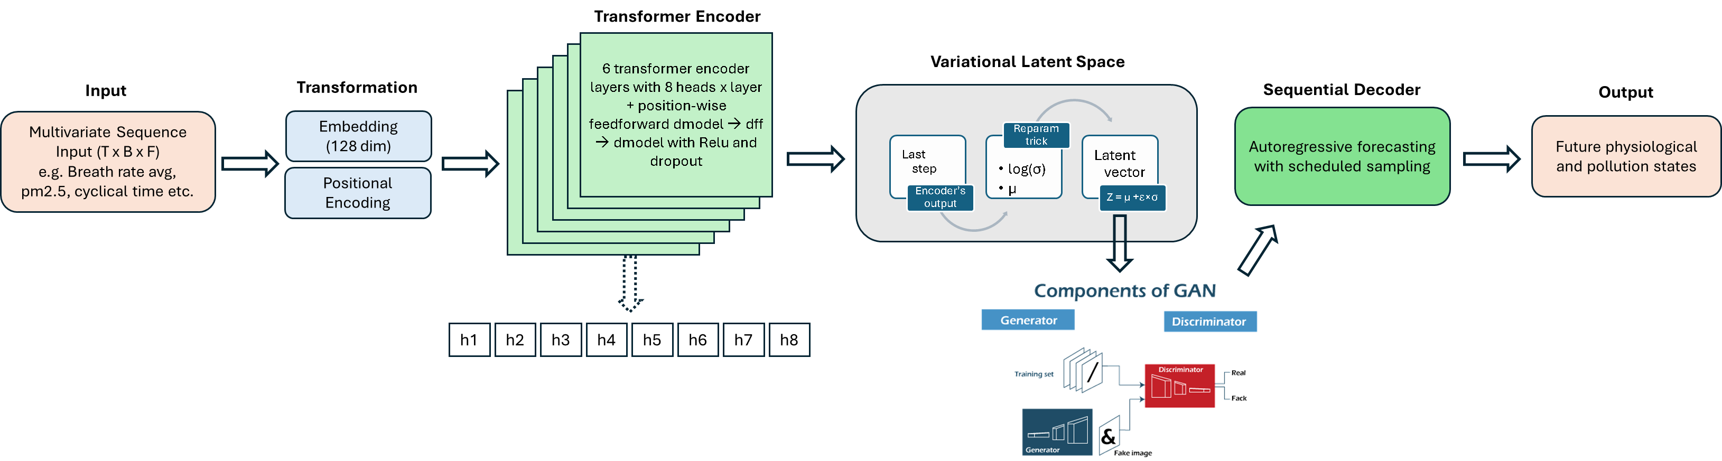
Hybrid Transformer-Gan model for physiological and time-series forecasting

Slide 38
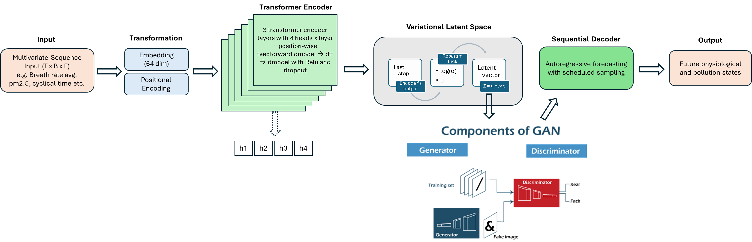

Slide 39
U
Useful for bla bla
Log
Z = μ +ε×σ
Latent Variable Space
Final encode state
Something to say

Slide 40
Variational Latent Space
Autoregressive forecasting with scheduled sampling
Future physiological and pollution states
log(σ²)
Final encoder state
Z = μ +ε×σ
μ

Slide 41
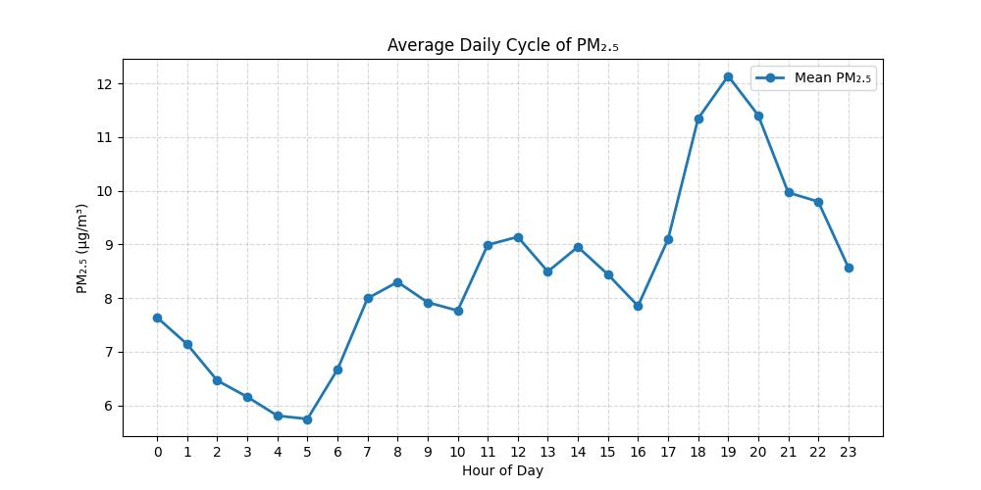
Inhale
The input includes tot number of features
To the input I will add Positional Encoding

Slide 42
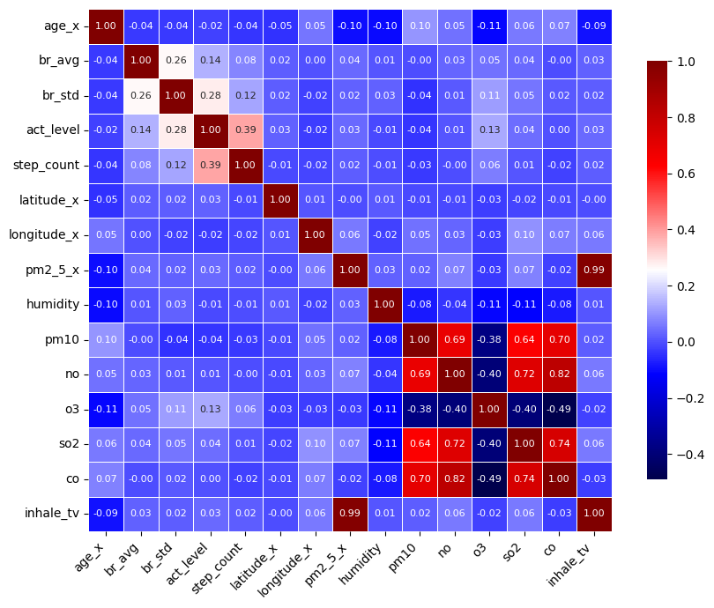
Correlation Matrix
Correlation Matrix between features

Slide 43
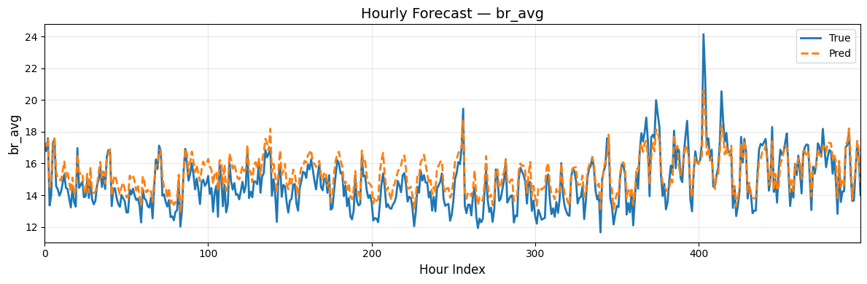
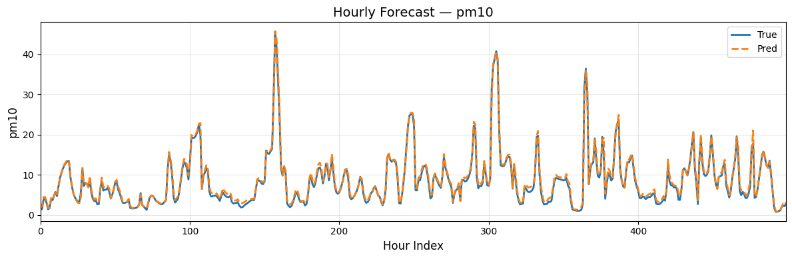
Hourly forecast general model

Slide 44
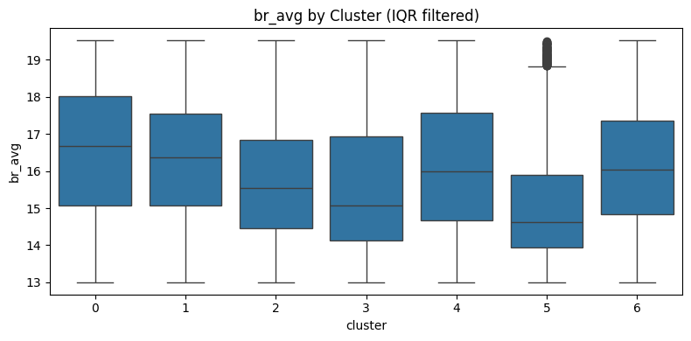
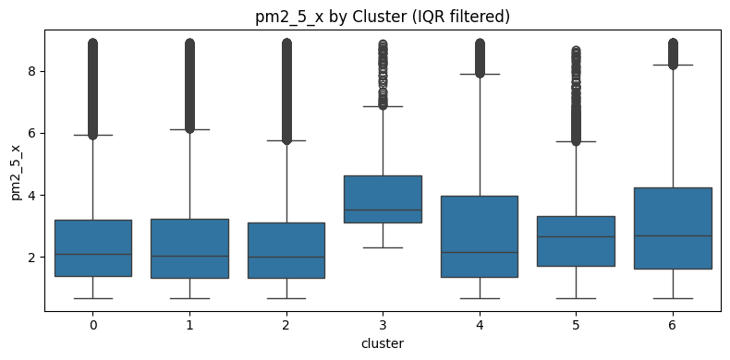
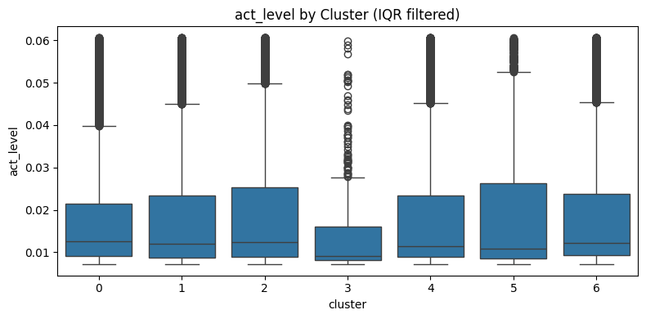
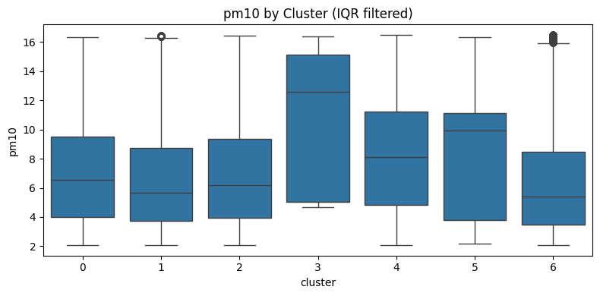
Dsitribution all individuals

Slide 45
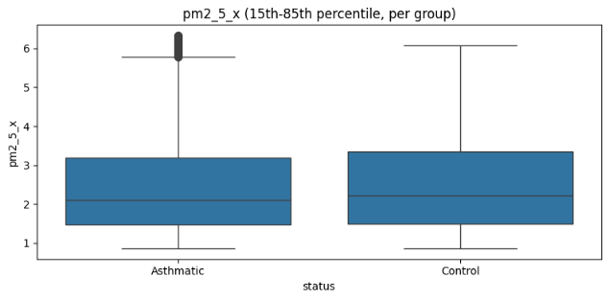
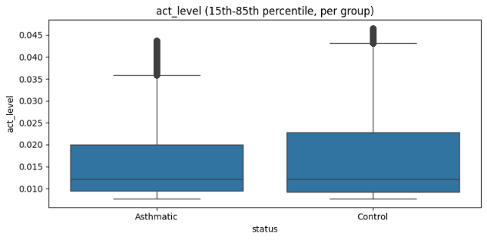
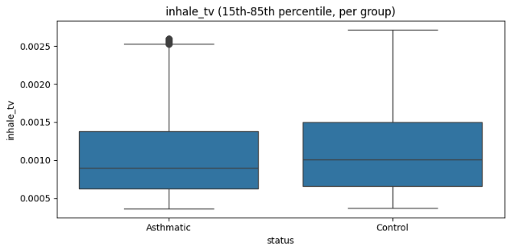
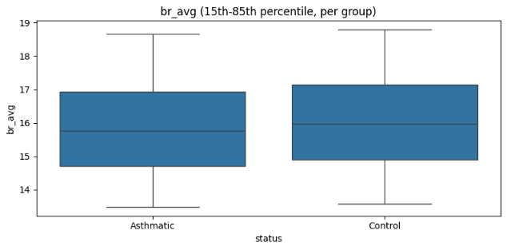
v

Slide 46
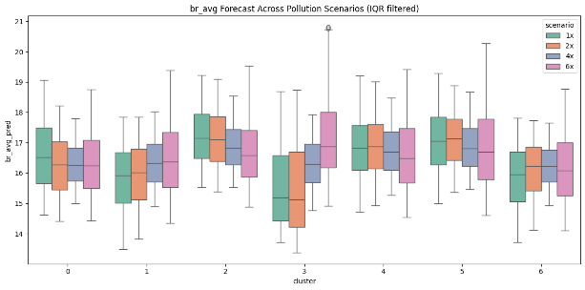
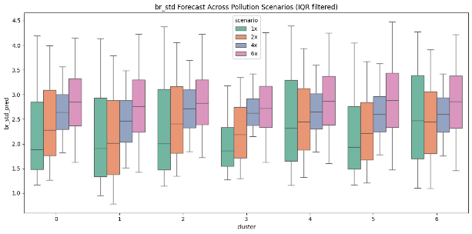

Slide 47
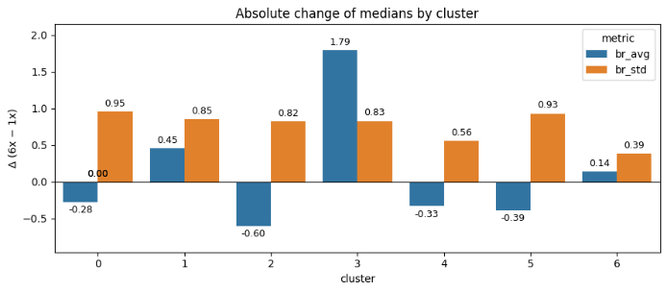
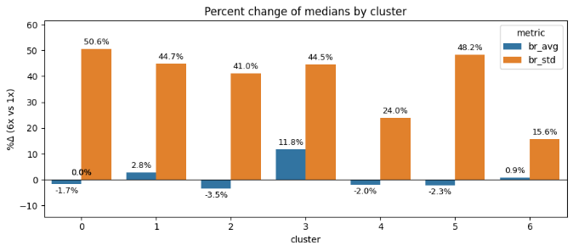

Slide 48
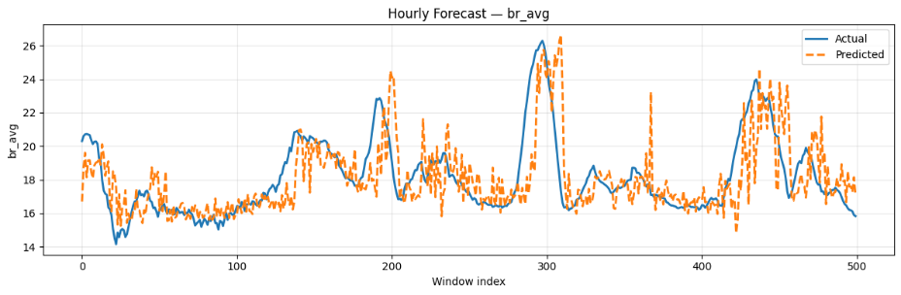
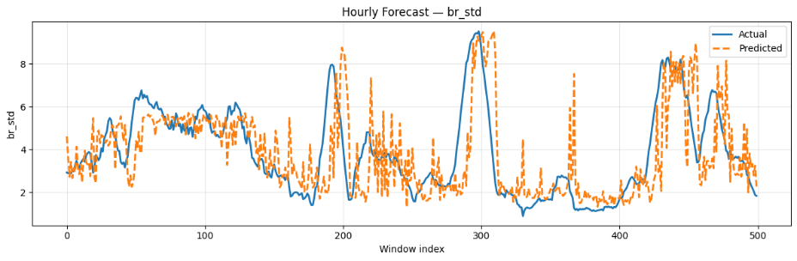

Slide 49
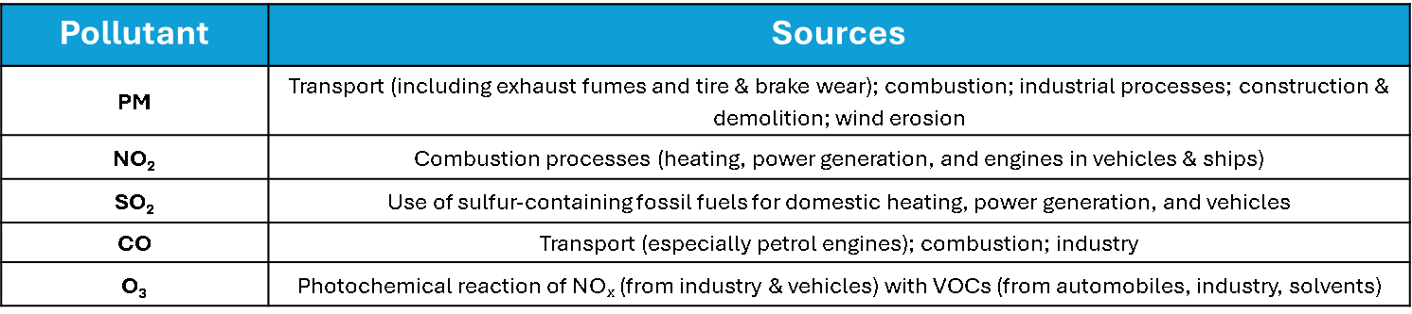
Pollutant | Sources
PM | Transport (including exhaust fumes and tire & brake wear); combustion; industrial processes; construction & demolition; wind erosion
NO₂ | Combustion processes (heating, power generation, and engines in vehicles & ships)
SO₂ | Use of sulfur-containing fossil fuels for domestic heating, power generation, and vehicles
CO | Transport (especially petrol engines); combustion; industry
O₃ | Photochemical reaction of NOₓ (from industry & vehicles) with VOCs (from automobiles, industry, solvents)

Slide 50
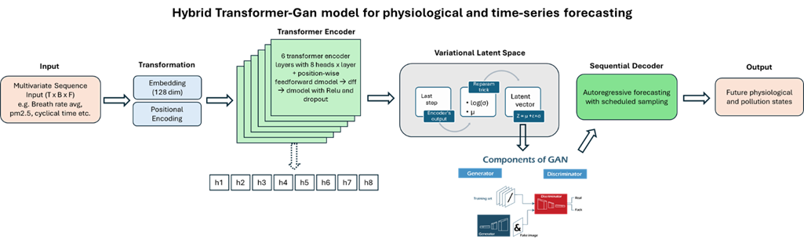

Slide 51



Slide 52
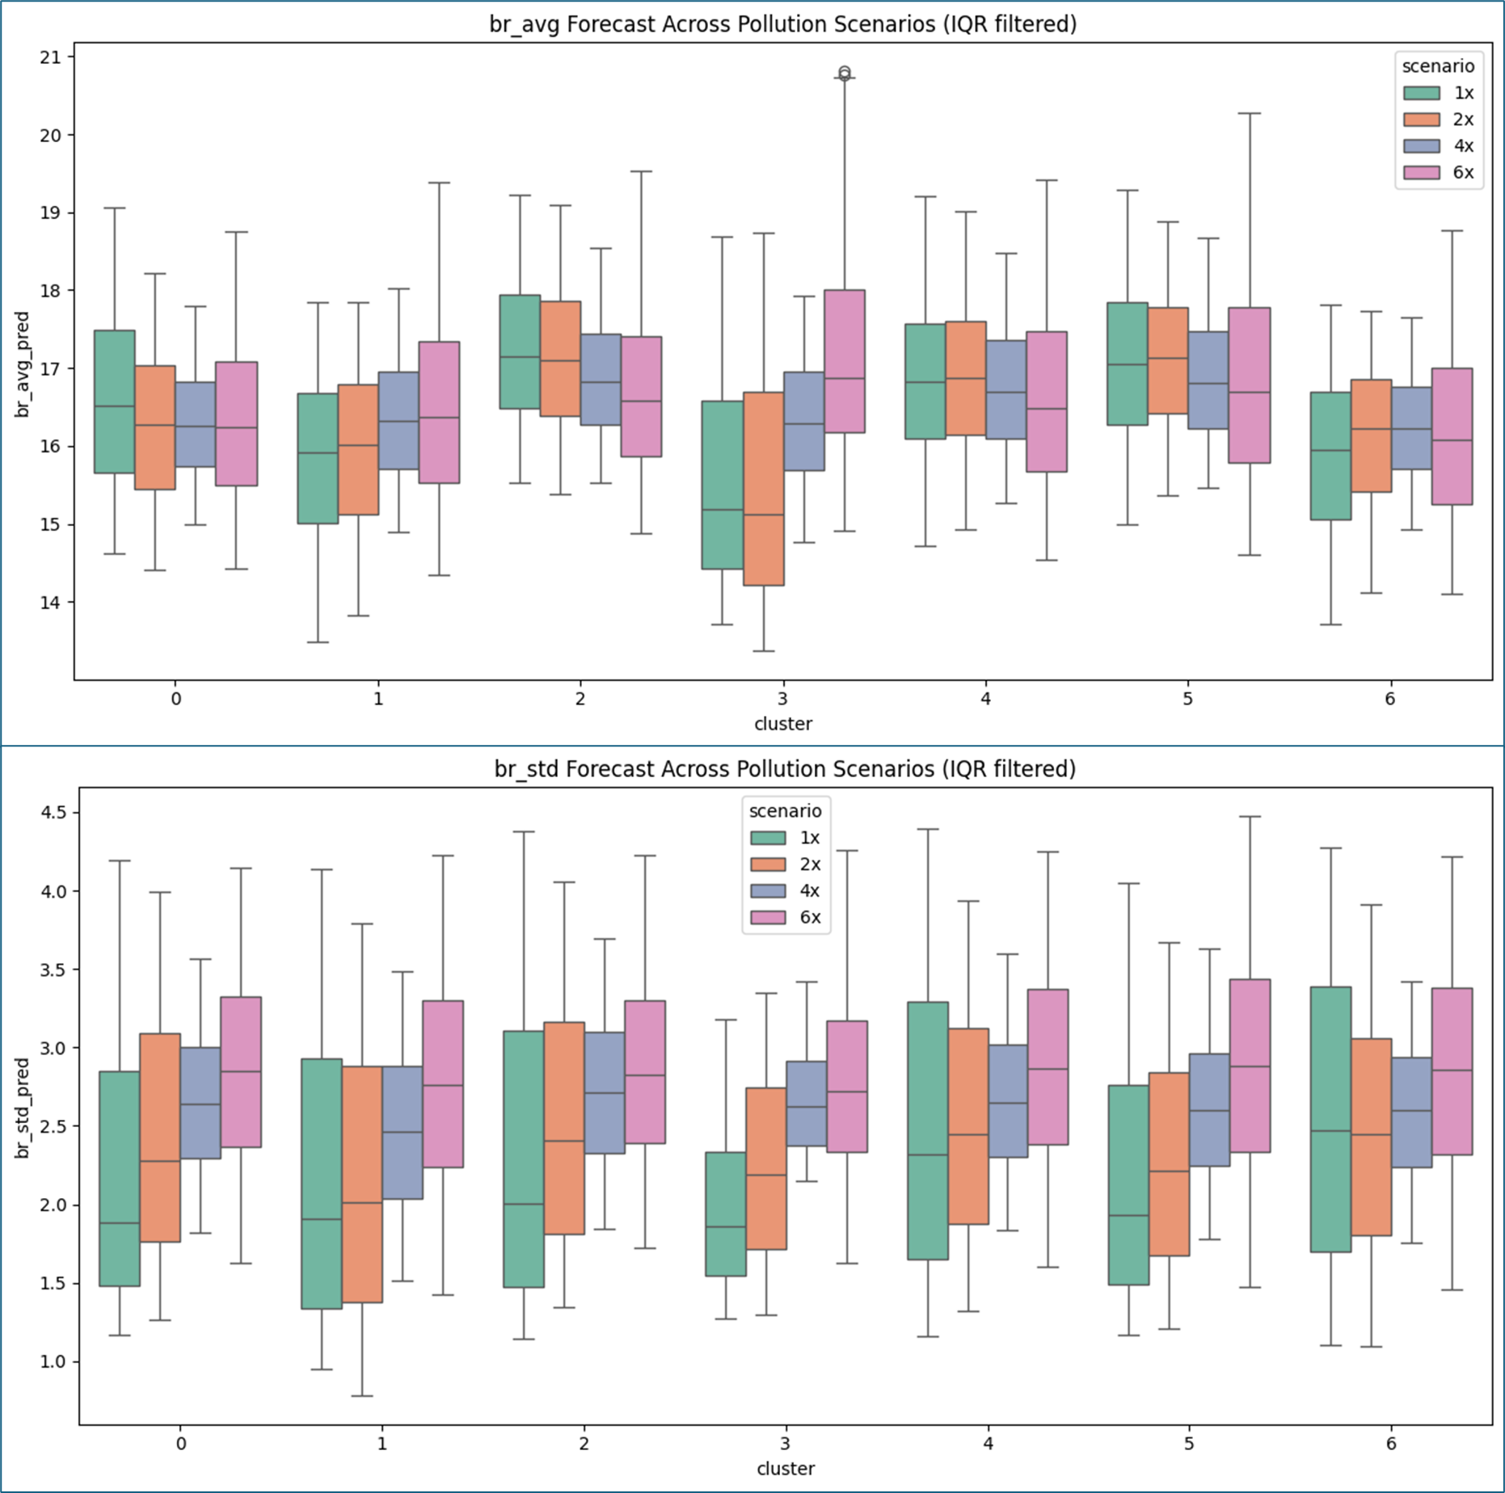

Slide 53
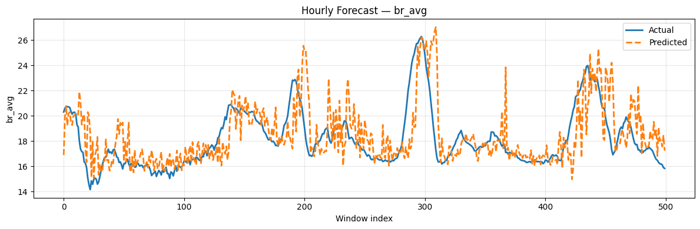
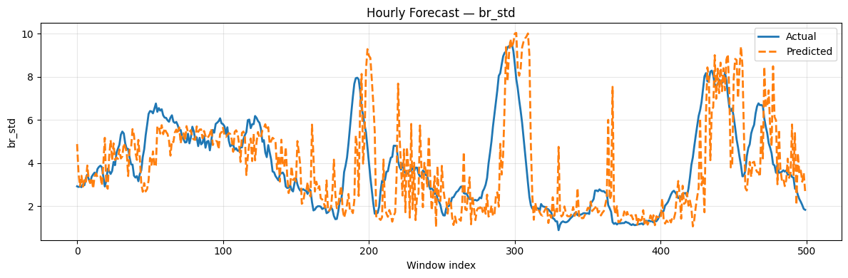

Slide 54
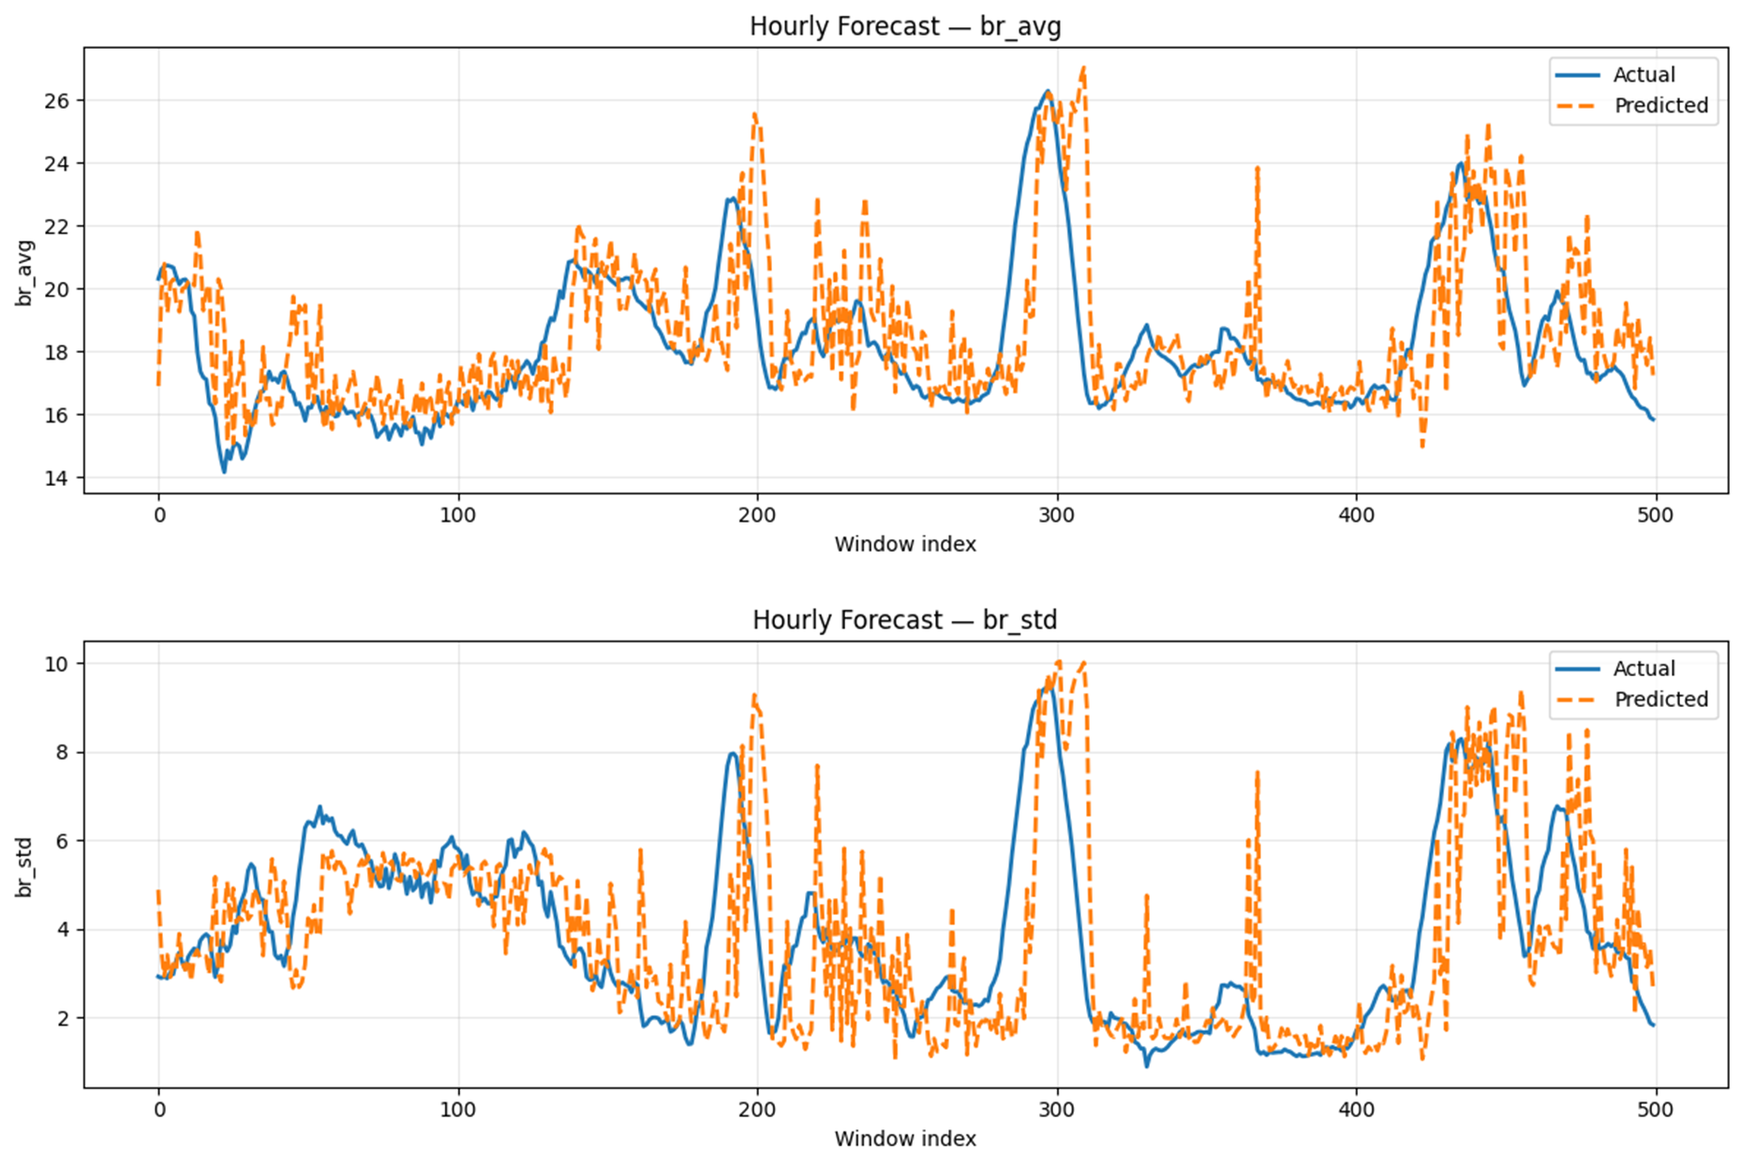

Slide 55
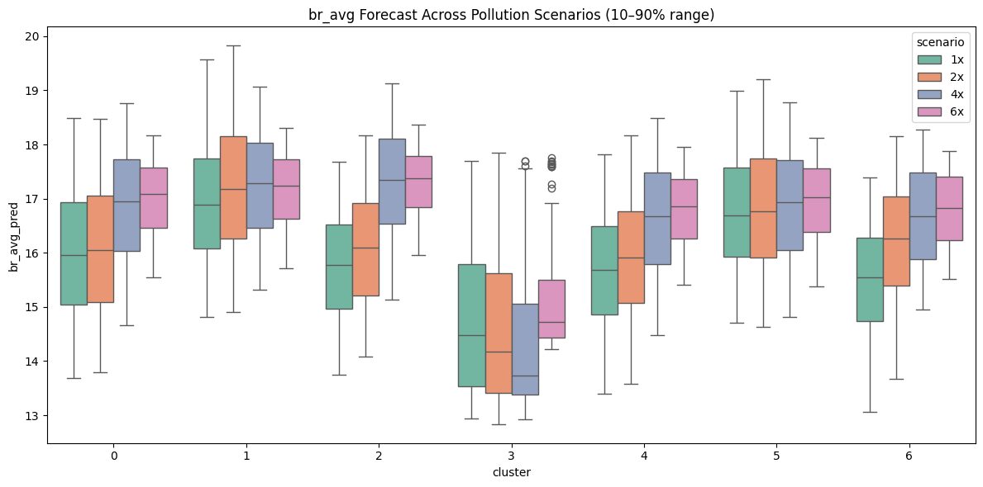


Slide 56
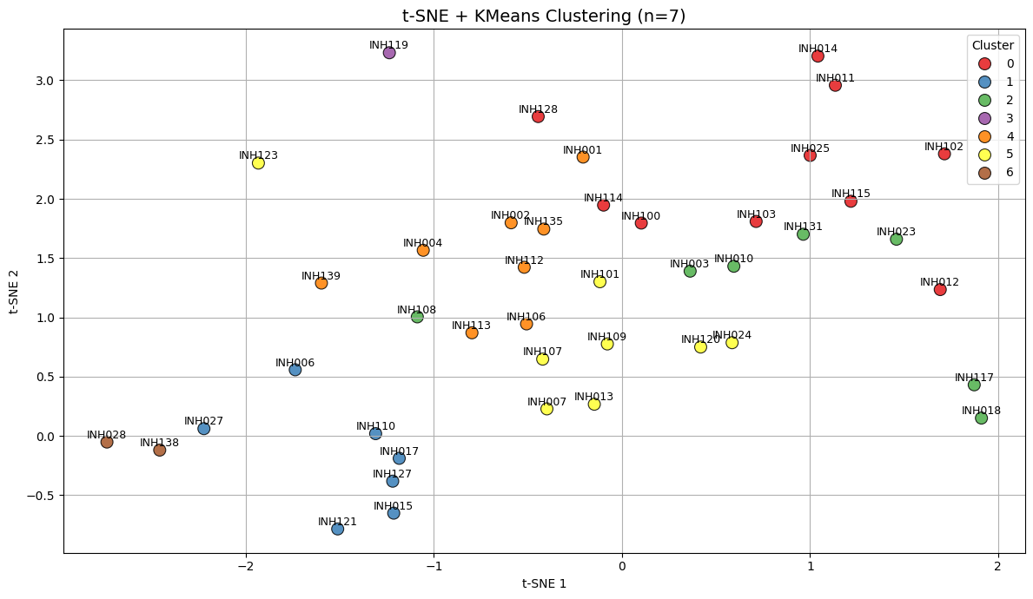

Slide 57
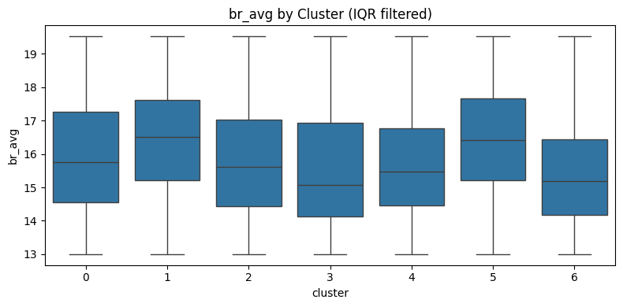
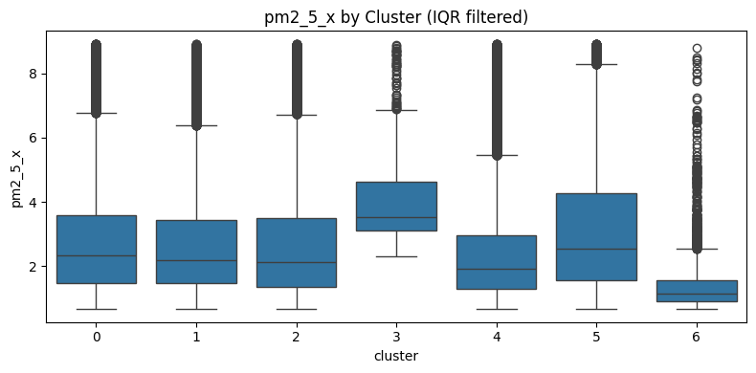
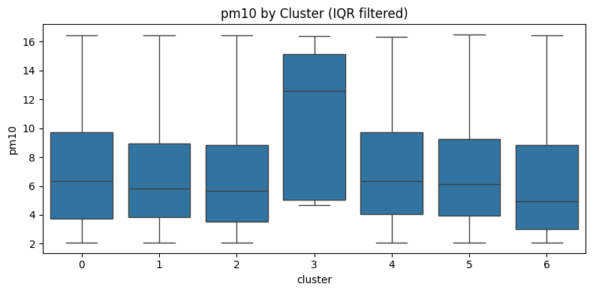
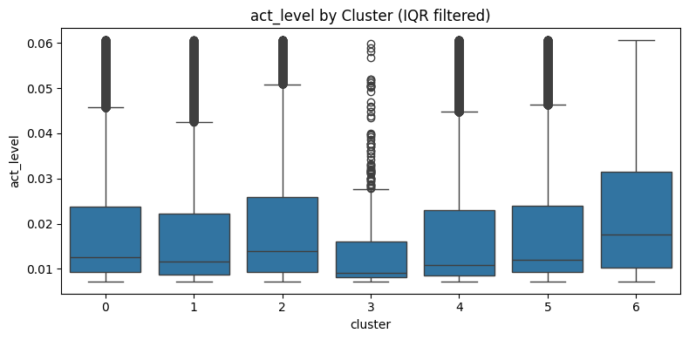

Slide 58
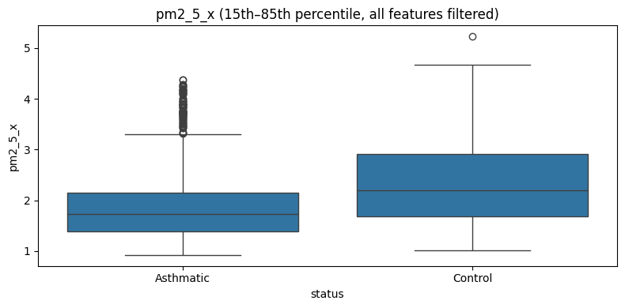
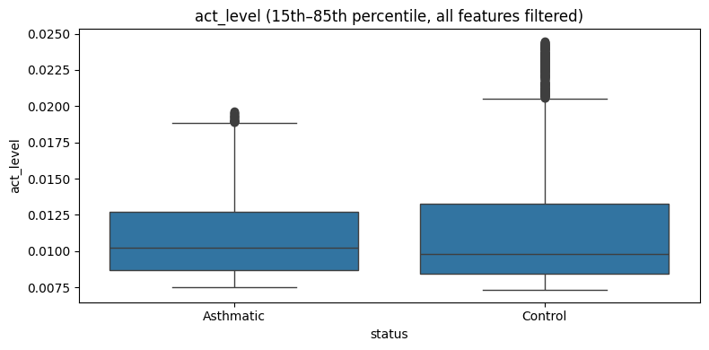
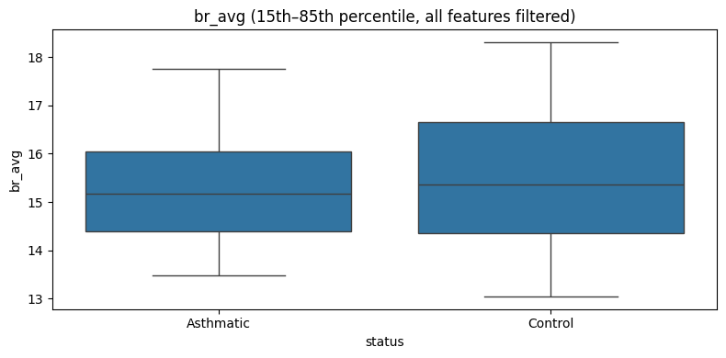


Slide 59



